Slide 1

Bosna i Hercegovina Agencija za rad i zapošljavanje Bosne i Hercegovine S A R A J E V O Bosnia and Herzegovina Labour and Employment Agency of Bosnia and Herzegovina S A R A J E V O |  | Босна и Херцеговина Агенција за рад и запошљавање Босне и Херцеговине С А Р А Ј Е В О Bosnia and Herzegovina Labour and Employment Agency of Bosnia and Herzegovina S A R A J E V O
Methods for monitoring efficiency of work in public employment services in Bosnia and Herzegovina
CPESSEC
Managerial Conference
Budapest, 08 November 2017

Slide 2

Strategic performance management
As a state-level institution, LEA BiH is obliged to prepare annual activity programmes and reports, mid-term activity reports and reports based on planning and achievement of objectives, programmes and projects that have their own performance measures.
Thanks to planning and reporting methods, it is possible to monitor the overall performance of the institution and of each individual sector, department and employee.
Advantages of this way of working are:
possibility to establish accountability of heads of institutions for allocated budget funds,
possibility to allocate resources to priority programme activities,
easy way to measure results and efficiency.

Slide 3
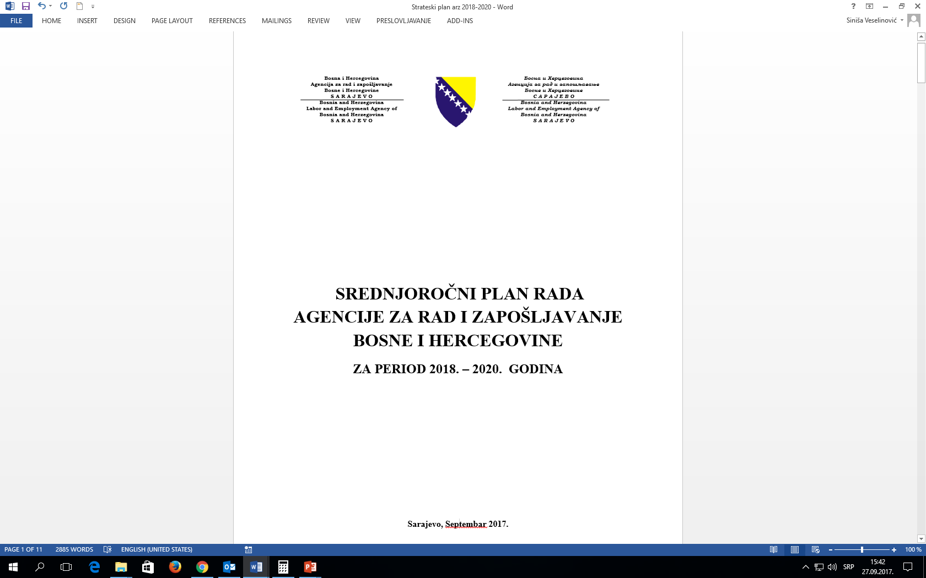
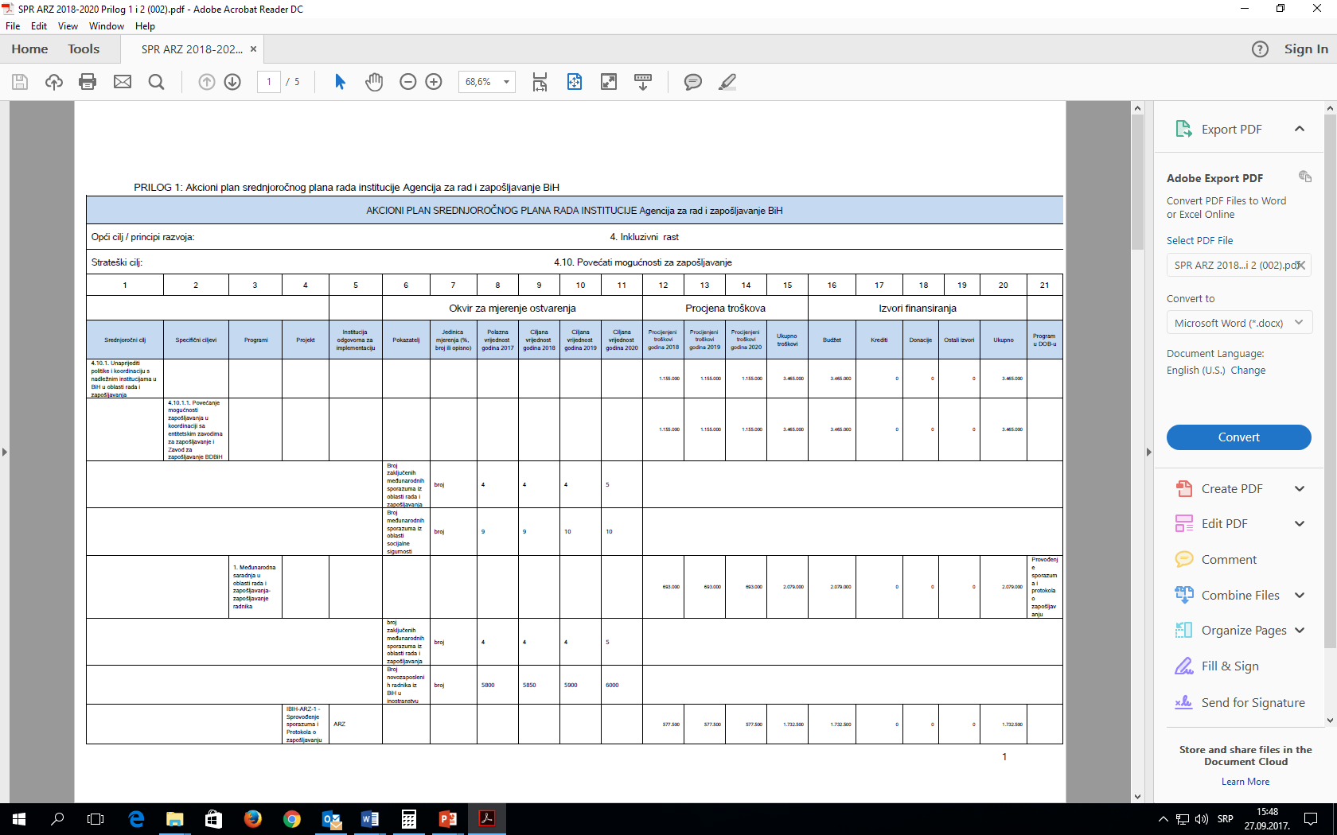
Example: LEA BiH Mid-term activity plan 2018-2020
1.STRATEŠKI OKVIR
2.IZJAVA O VIZIJI I MISIJI ARZ BIH 2.1. VIZIJA 2.2 MISIJA
3.UČESNICI I PARTNERI
4.OSNOVNA PROGRAMSKA OPREDJELJENJA
5.RESURSI I KAPACITETI POTREBNI ZA POSTIZANJE CILJEVA
6.OKVIR ZA PRAĆENJE PROVOĐENJA PLANA I EVALUACIJA REZULTATA
PRILOG AKCIONI PLAN SREDNJOROČNOG PLANA RADA AGENCIJE ZA RAD I ZAPOŠLJAVANJE BIH

Slide 4
2. Design of operational processes such as effective channelling and profiling of jobseekers and tailored use of active labour market instruments
-Example 1: Implementation of YEP Project is underway – Reform package that aims to:
improve operation of municipal PES offices by introducing more efficient administrative procedures and counselling services,
develop a contemporary performance management system (change of working practices and improvement of infrastructure (refurbishment and new technical equipment) run in parallel.
- The Project provides for:
Separation of counselling from administrative jobs,
Introduction of individual and group counselling services,
Job mediation tailored to employers‘ needs,
Training of municipal PES offices‘ staff to work with contemporary working methods,
Adjustment of office premises to new working methods (reception points, counsellors‘ offices and rooms for group counselling sessions),
Establishing of IT system and performance monitoring and management system to assess effects of new working methods.

Slide 5
Example 2: Employment Service of Republika Srpska – introduced an IT application to enhance counselling processes
The new solution provides for efficient and safe case management: personal unemployment card, calendar of reporting, counselling process and individual employment plan.
Data entry and further updates are based on intelligent templates that simplify and accelerate data entry process with high level of automation and built-in logic checks designed to prevent data entry errors.

Slide 6
3. Sustainable activation and management of transitions
- Public employment services in BiH establish counselling and ALMP systems in order to respond timely with early intervention and activation - measures that prevent early drop-outs and provide support in activation of inactive disadvantaged groups (youth, older persons, low skilled persons, etc.).
-This includes: 1. Labour market integration – reforms and measures aimed at activation in the labour market through creation of new jobs, incentives to employers to offer good quality on-the-job training programmes, incentives for entrepreneurship. 2. Reform of education system and its adjustment to labour market needs. 3. Establishing an adult education system in entire BiH.

Slide 7
- PES transition from a record-keeping into an active labour market institution
Practical experience has shown that setting up a modern public employment service in accordance with best European practices can lead to a more efficient system. This approach includes working with PES staff in the field (employment offices), a change in organisational structure and system of work, a change in work philosophy focused on service beneficiaries, performance orientation and improvement of working practices and change of physical environment.
The most important step in the entire reform is the introduction of a performance monitoring and measurement system in PES that is used to define institutional objectives.
The expected result of all activities is a new model of working with clients in all public employment services in BiH that will represent an added value of PES and change the perception and expectations of job seekers and the general public.

Slide 8
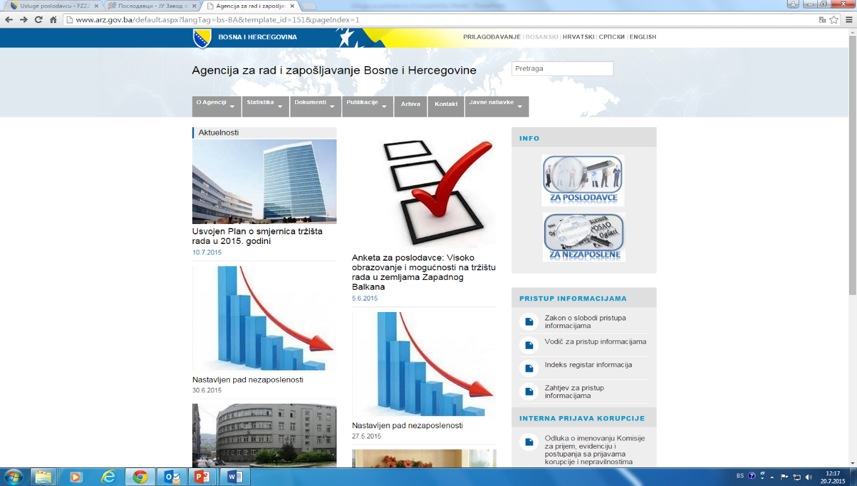
4. Relations to employers
1) Implementation of employment agreements signed between BiH and other countries
Bosnia and Herzegovina has signed employment agreements with the following countries:
-Slovenia,
-Serbia,
-Germany (medical workers – nurses, summer jobs for students),
-State of Qatar.
- On-line service for international employers : www.arz.gov.ba

Slide 9
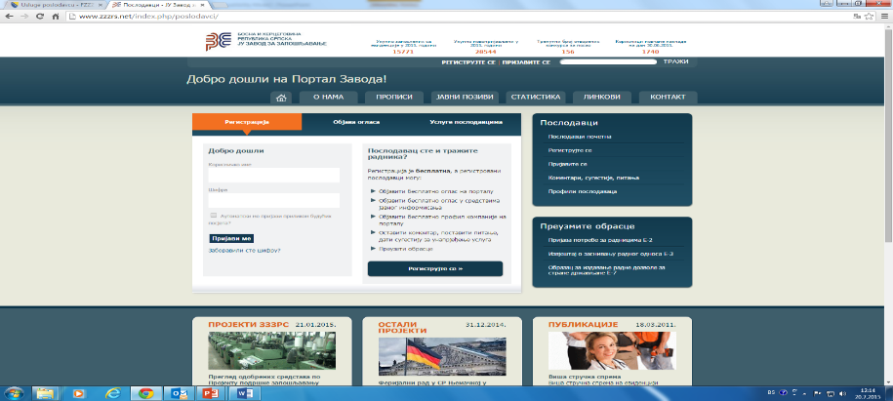
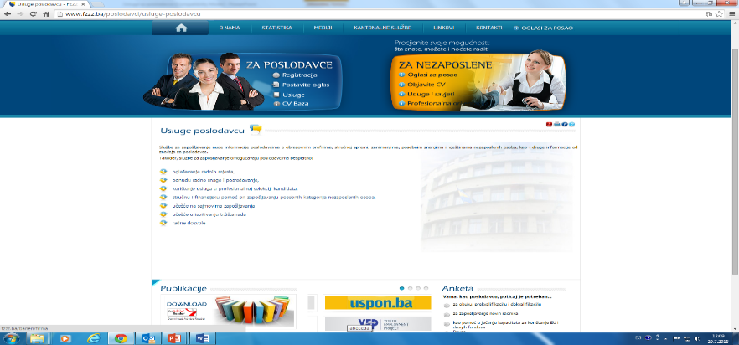
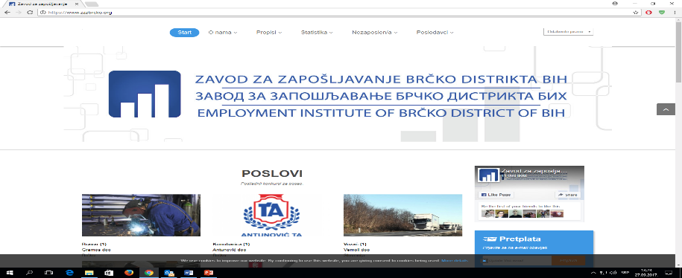
PES in BiH provide the following services to employers from BiH:
announcement of vacancies,
work force supply and mediation services,
professional selection of candidates,
expert and financial assistance in recruitment of special categories of the unemployed,
participation in emplyoment fairs,
participation in labour market surveys,
issuance of work permits for foreign workers.
All services are accessible on-line at relevant PES websites
FBiH Employment Service and cantonal employment services (www.fzzz.ba)
Employment Service of Republika Srpska
www.zzzrs.net
Employment Service of Brčko District BiH
www.zzzbrcko.org

Slide 10
5. Evidence-based design and implementation of PES services
Job clubs
Job club is an active labour market measure that provides continuous support to young unemployed individuals in their job seeking activities.
A network of 29 such clubs operating within PESs was set up in BiH and these are administered by counsellors employed in employment offices.
There is a great interest among clients and an obvious need to set up new clubs and strengthen the counselling function for youth in all public employment services in BiH.
Job club is a measure that combines skills enhancement, job search discipline and counselling support which is what makes its methodology different to all other methods. Job club is not only a training on CV writing, scouring of job advertisements or simulating job interviews, it also includes group support from other job seekers and counsellors with one common goal – to find a job in shortest time possible.

Slide 11
In order to motivate the counsellors employed in job clubs a performance measurement system was set up to compare successfulness between clubs.
Performance measurement is based on established indicators, such as the number of training participants, their level of job-seeking activity and ultimately, the number of transitions in employment.
7 098 young people (4 266 women and 2 832 men) underwent training and received support provided by job clubs since the start of this measure; 3 090 of them (1 871 women and 1 219 men) found jobs either during or 6 months after the programme which is a very good average that exceeds results of majority of other ALMP measures in BiH.

Slide 12
6. Effective management of partnerships with stakeholders
Triple Win Project
Lead partners in the “Triple Win” project are the Labour and Employment Agency of BiH and International Placement Services (ZAV) of the German Federal Employment Agency. The project is supported by the German Agency for International Cooperation (GIZ).
The aim of the project is to train and recruit qualified nurses from Bosnia and Herzegovina to work in Germany.
The project is implemented by means of an open call of the Labour and Employment Agency of BiH that is implemented by Entity employment services and the Employment Service of Brčko District BiH.
Triple Win is aimed at addressing the needs of the employers, the nurses, the countries of origin and employment and their relevant public employment service.

Slide 13
Project implementation process:
After checking the received applications, representatives of ZAV conduct interviews with short-listed candidates.
Candidates that lack the required German skills (minimum B1 CEFR level), but have scored high in the interview are included in language courses organized in cooperation with the Goethe Institute.
Candidates that meet all requirements undergo the recruitment procedure that may include an interview with their prospective employers before signing employment contracts.
The bilingual employment contract that is constituent part of the Inter-state agreement is then signed by the employer and the worker and signed and sealed by the two state-level employment agencies and as such guarantees job security and exercise of all rights to workers taking employment in Germany.
The workers who have taken employment in Germany are obliged to initiate the procedure of recognition of their professional qualifications within a year from taking employment, otherwise ZAV will refuse to renew the approval for employment as the basis for residence title in Germany.
Successfully completed recognition procedure is the basis for signing an indefinite employment contract and extension of residence permit in Germany (twice
for a period of two years and then long-term residence permit).

Slide 14
7. Allocation of PES resources (both human and financial)
Public employment services in BiH currently have 934 staff members in total; about 55% of them are in direct contact with clients.
Average caseload per counsellor is 1100 job seekers.
With a view of introducing contemporary work practices in PES in BiH, it is necessary to:
separate active from inactive job seekers, i. e. persons who register merely to claim unemployment rights,
separate administrative from counselling jobs in PES,
introduce counter service and IT tools as a way of communication with job seekers and employers.
set up a system of performance-based evaluation of work in PES.

Slide 15
Financial resources of PES in BiH consist of:
Unemployment contributions,
Grants.
These resources are used to finance (in the following order of priority):
operation of PES,
passive measures (unemployment cash benefit, health insurance in FBiH, contributions that are conditional for pension),
ALMPs.

Slide 16
Labour and Employment Agency of Bosnia and Herzegovina Thank you for your attention!

