Slide 1

CPESSEC Managerial Conference
-
Integration of Long-term Unemployed- Management Models and Case Studies from the Southeast European Region
Budapest, 8 November 2017

Slide 2

About Croatia
GDP per capita (2016): 10,990 €
Labour force according to administrative sources September 2017
Active population (labour force): 1,557,493
Employed persons: 1,388,559
Unemployed persons: 168,934
Registered unemployment rate: 10.8%
Young unemployed persons: (15-24) 26,595 (15.7%); (15-29) 44,272 (26.2%)
Long term unemployed persons (12 months +): 83,850 (49.6%)
Unemployment benefit users: 27.623 (16.4%)
Labour Force Survey
Q2, 2017
Working age population: 3,548,000
Active population: 1,834,000
Persons in employment: 1,633,000
Employment rate: 59.2% (15-64)
Unemployed persons: 201,000
Unemployment rate: 11.0%
Youth unemployment rate: 20.5% (15-24);
18.9% (15-29)
Source: Croatian Bureau of Statistics, www.dzs.hr
Hrvatski zavod za zapošljavanje, www.hzz.hr
The Republic of Croatia (56 594 km2)
Population: 4 290 612 inhabitants (Census 2011)
21 counties, 127 towns
The capital: Zagreb

Slide 3
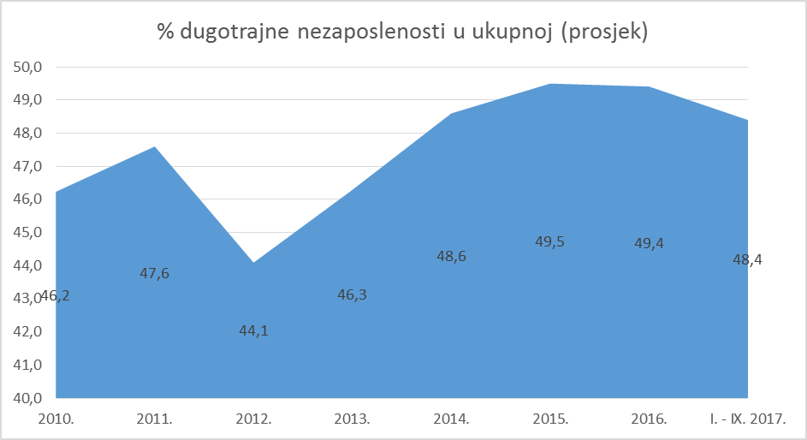
Registered LTU
The share of LTU ranges from 44,1% (2012) to 49,5% (2015) and 48,4% (2017)

Slide 4
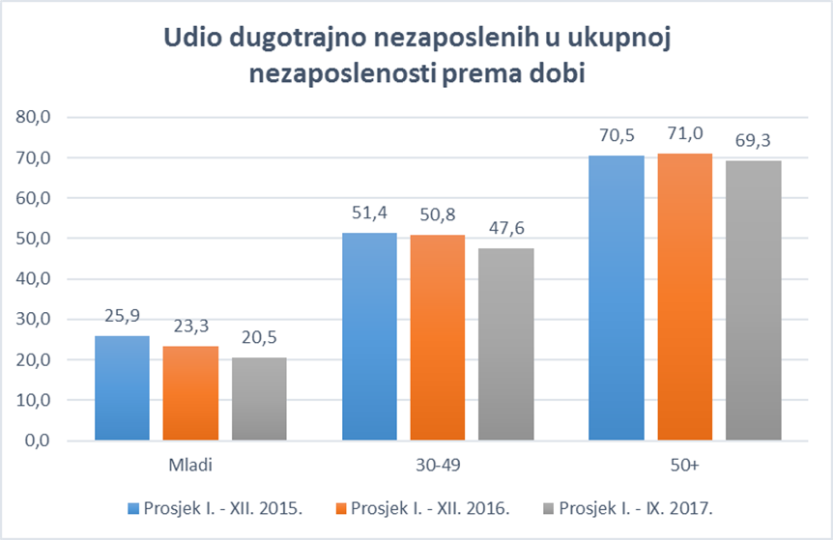
LTU – age groups

Slide 5
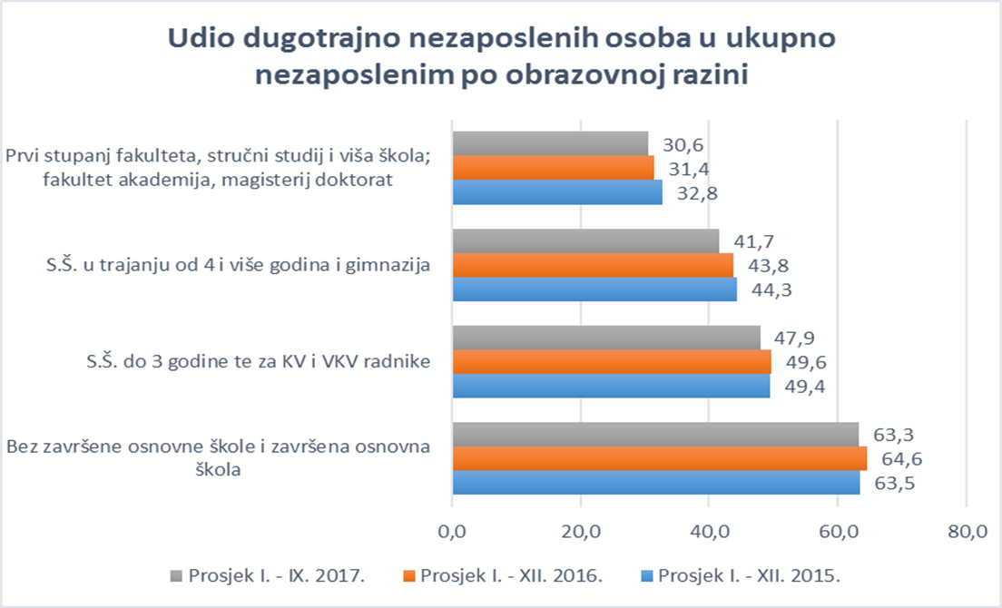
LTU – educational level

Slide 6
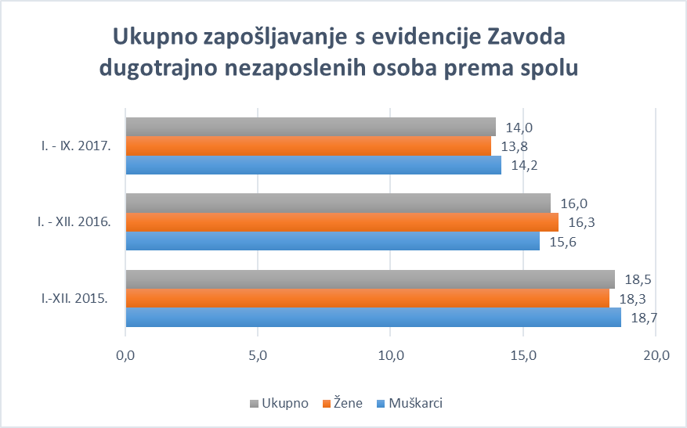
Employment of LTU

Slide 7
Shortages in the Croatian labour market
Sectors and occupations where candidates are most in demand:
Construction (carpenter, bricklayer, concrete placer, electrician, drywall fitter, painter, roofer, plasterer, tiler, crane operator)
Metal Industry/ Shipbuilding (mechanical engineer, electrical engineer, toolsharpener, shipfitter, welder, shippipefitter, scaffolder, electrowelder, blacksmith, painter/ anticorrosion painter)
Tourism and catering (waiter, cook )
Transport (lorry driver, bus driver)
Healthcare (medical doctor, dentist, nurse, pharmacist, physical therapist)
Manufacturing (butcher)
IT (IT specialist, programmer, software engineer, system engineer)
Notes:
7

Slide 8
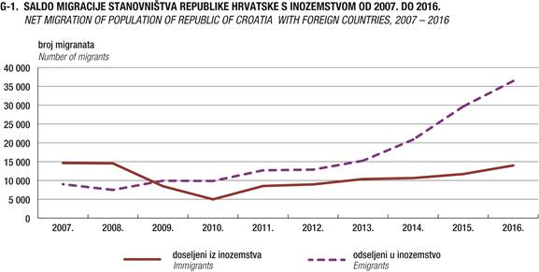
External migrations

Slide 9
Institutional structural development – services
New services for long-term unemployed
Specialized counsellors for LTU
Motivation counselling and activation programmes
Statistically Assisted Profiling (StAP)
Lifelong career guidance services
New ALMP measures for vulnerable groups (LTU)
Several partnerships with schools, Social Welfare Centres and Local Partnerships for Employment

Slide 10
Specialised services for LTU
Specialized counsellors for LTU
Reorganisation of counsellors work carried out in 2015
Activation counsellors (PWD counsellors)
Training – counsellors trained to use an individualized approach (motivational counselling)
Segmentation of clients
Additional two segments for clients in risk of becoming LTU
employable with the support
employable with activation programs
New procedures in the counselling the LTU
Motivational counselling
Counsellors assessment on the need of the jobseeker’s training (in the institution or workplace)
Workshops for LTU (purpose – assessing jobseeker’s own capabilities and limitations and enhancing motivation)

Slide 11
Profiling as activation tool
Counsellor
Intervention
€
big
2
high

Intensive work and targeted activities – physical contact

High-risk group

3


Unemployed person
1
Combined activities, additional training and emplyment preparation

Middle risk group
Priority level

Distance from the LM
Distirbution of resources

Low risk group
„Self-service” and matching – digital contact
small
low
Client segmentation
Targeted interventions (activities)
Resources planing

Slide 12
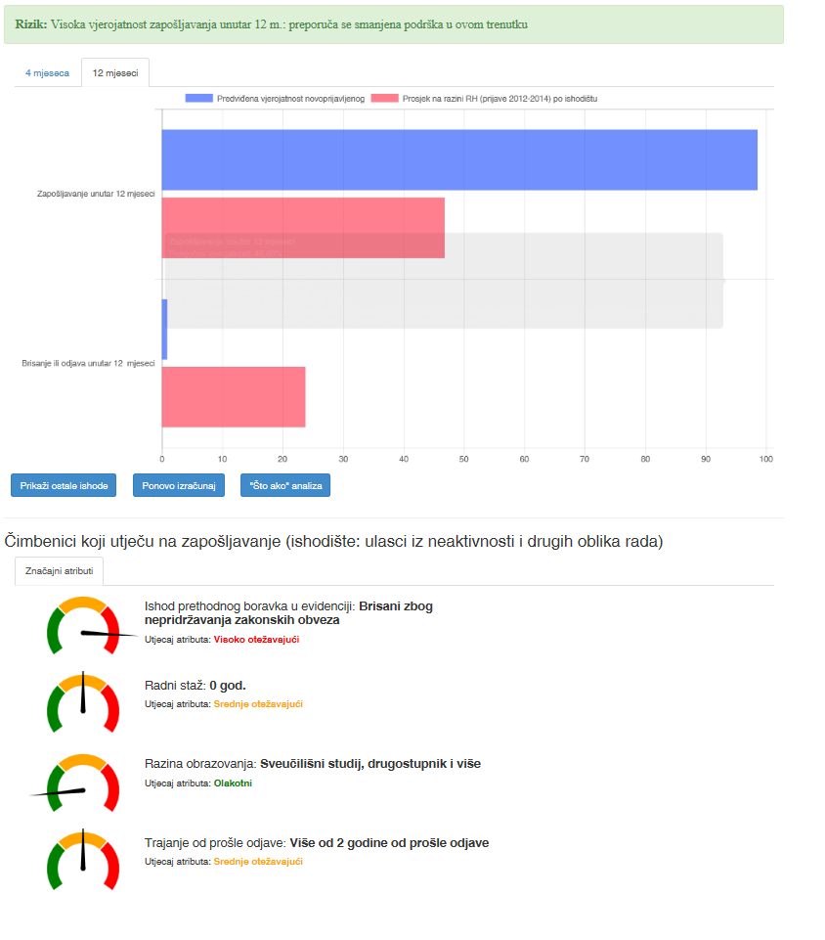

The benefits of the StAP
The StAP lets you apply early intervention to persons belonging to the highest risk groups in order to avoid further deterioration of their skills
With the very high caseload of counsellors, it is difficult to perform equal interventions for all unemployed persons
The StAP helps with more accurate grouping of individuals and unburdens scarce resources to work with the groups most at risk

Slide 13
Lifelong career guidance services
Differentiated service delivery models
Improved accesibility of the services to clients (e-services, self-help services, group activities)
Client-oriented approach
Standardization of the methods and procedures toward different target groups (LLCG Quality Standards - 2nd version)
Activities toward better linking education and employment
„Early intervention” activities with pupils
Job fairs, Career days, craft occupations promotion...
Brochures, e-guidance portal (on-line self help tools), LMIS
12 Lifelong Career Guidance Centres (CISOK)
Recommendations for the Enrollment and Scholarship Policy - on annual basis
Self-help services
Assisted services
Tailored services & intensive support

Slide 14
Work with the Employers
Work with employers at CES is organized through:
Employment counsellors – work with both the employers, with whom they have established cooperation and with the unemployed persons in order to mediate efficiently
Offices for Employers - designed as one-stop-shops for employers in 5 Regional Centres
Key employers counsellors – in charge of mediating for all job vacancies, referring workers, contacts during mediation and maintaining contacts with key employers throughout the year
All Regional and Local Offices offer services of:
Mediation
Recruitment and professional selection
Publication of job vacancies (web, bulletin board, display board)
On-line advertising of job vacancies
ALMP
SME councelling
Mobile teams
Notes:
Work with employers at CES is organized through:
Employment counsellors – work with both the employers, with whom they have established cooperation and with the unemployed persons in order to mediate efficiently
Offices for Employers - designed as one-stop-shops for employers in 5 Regional Centres
Key employers counsellors – in charge of mediating for all job vacancies, referring workers, contacts during mediation and maintaining contacts with key employers throughout the year
The main goal is to provide all employers with the information on CES services, publish job vacancies, provide advice to employers and improve the cooperation with current employers as well as attract new employers-
The focus is on the employers who have a network in the whole territory of the Republic of Croatia, employers with shortages of workers and employers who employ seasonal workers during summer. Counsellors are oriented at the mentioned groups of employers in order to meet employers needs.

Slide 15
PUBLIC WORKS /DIRECT JOB CREATION
TRAINING
➲ Training of the unemployed
➲ Training of the employed
➲ Workplace training
EMPLOYMENT SUBSIDIES / EMPLOYMENT INCENTIVES
JOB
PRESERVATION
SUBSIDIES
SELF-EMPLOYMENT SUBSIDIES /START-UP INCENTIVES
ALMP measures for LTU

Slide 16
Notes:
Percentage of counsellors directly servicing the clients
According to the specialization the biggest proprtion belongs to counsellors providing support to young persons (19%) , then support to long-term unemployed (17%), and counsellors doing job mediation services (16%). Also 9% of counsellors are not speciallized as they work in local offices.
As regards huge interest of employers, in the recent years, there is a growing number of counsellors for ALMP measures. (14%)

Slide 17
Financial Management
FINACIAL PLAN (FP) is prepared in line with the methodology for preparation of the state budget, i.e. in line with:
Strategy of government programmes for the three-year period,
Government guidelines of economic and fiscal policy for a three-year period
Instructions of the Ministry of Finance and the supervising Ministry of Labour and Pension System
Resources of financing the HZZ activities are:
contributions to employment (1.7% of gross salary)
other resources which are paid to the account of the State Budget
Structure of Expenditures
In the HZZ Financial Plan the resources for the following expenditures are foreseen for:
unemployed persons
participants in active labour market policy measures
other obligations which occur based on legal regulations or contracts (material and financialexpenditures, expenditures for assets, obligations towards employees…)
Control and supervision of the financial affairs of the HZZ can be performed by:
National Audit Office - the audit of public revenues and expenditures, financial statements and financial transactions
Budgetary control - inspection of legality, purposefulness and timeliness of budgetary funds
Internal audit - an independent activity which evaluates the internal control system, provides expertise and advice for business improvement
Agency audits of the implementation of EU programs
Notes:
Financial plan contains projects financed from the EU structured funds and other resources.
FINACIAL PLAN (FP) is prepared in line with the methodology for preparation of the state budget, i.e. in line with:
Strategy of government programmes for the three-year period,
Government guidelines of economic and fiscal policy for a three-year period
Instructions of the Ministry of Finance and the supervising Ministry of Labour and Pension System.
Control and supervision of the financial affairs is performed by the National Audit Office, internal audit and agency audits of the implemetation of EU programmes.

Slide 18


HRVATSKI ZAVOD ZA ZAPOŠLJAVANJE
Radnička cesta 1
10000 Zagreb
+385-1-6126-000
+385-1-6126-038
hzz@hzz.hr *** www.hzz.hr
THANK YOU FOR YOUR ATTENTION!

