Slide 1
Vulnerable employment, underemployment and skills development
CPESSEC Managers’ and experts’ level meetings
Budapest, 8-9 November 2017
Daniela Zampini
Employment and Skills Specialist
International Labour Office

Slide 2
Key message (1)
Social and demographic changes pressure the public employment services to reach out to and treat ‘non-traditional’ groups, BEYOND THE UNEMPLOYMENT REGISTER.
This may include inactive, informally employed, underemployed, and migrant workers.

Slide 3
Why it is useful to look at those not working
Unemployed
Frictional Unemployment
Long-term unemployed
Inactive
Discouraged worker
Volunteer work
Willing non-jobseekers

Slide 4
Political and social dimensions of measured unemployment and underemployment (1)
A reported lower unemployment rate may not be an unequivocally positive event or an unambiguous sign of improved labour market outcomes.
Focus is on measuring quantity and QUALITY of jobs

Slide 5
KILM – Key Indicators of the Labour Market
1. Labour Force Participation Rate | 10. Youth unemployment
2. Employment-to-Population Ratio | 11. Long-term unemployment
3. Employment by status | 12. Time-related underemployment
4. Employment by sector | 13. Inactivity
5. Employment by occupation | 14. Educ. attainment and illiteracy
6. Part-time workers | 15. Average wages
7. Hours of work | 16. Hourly compensation costs
8. Employment in the informal economy | 17. Labour Productivity
9. Unemployment | 18. Poverty, income distr. Working poor

Slide 6
Labour Force Framework
Working age population (15+ or 15-64)
Labour Force
(=Economically Active Population)
Inactive Population
Employed
Unemployed

Slide 7
Labour underutilization
“Refers to mismatches
between labour supply and demand,
which translate into an unmet need for employment among the population”
  Para 40,Resol I. (19th ICLS, 2013)
In reference to employment (work for pay or profit)
Focuses on issues of insufficient labour absorption
For monitoring labour markets

Slide 8
Underutilization
Time-related underemployment
  Working time is insufficient in relation to alternative employment they are willing and available to work
Potential labour force
  Interested in work, but whose current conditions limit their active job search and availability

Slide 9
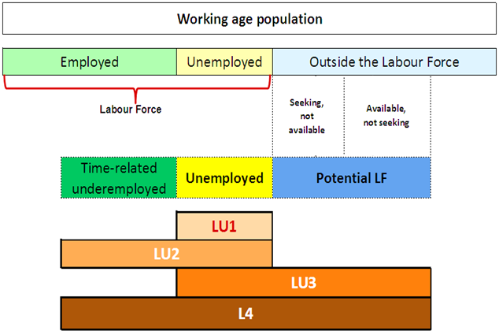
NEW measures of labour underutilization (LU1-LU4)
LU4

Slide 10
Political and social dimensions of measured unemployment and underemployment (2)
Is it desirable to have workers drop out of the labour force, thereby disappearing from the unemployment roster, because the wage of the jobs they are offered is less than the statutory minimum and insufficient for their family’s subsistence?

Slide 11
Political and social dimensions of measured unemployment and underemployment (3)
Should we really welcome diminished unemployment if it were solely accomplished by lower unemployment benefits, or a reduction of the share of workers eligible for them?
Is it sufficient to aspire to a “full-employment- economy”?

Slide 12

Following the headlines

Slide 13

Following the headlines:
Italy – Sept 2017
ISTAT: In this last quarter employment finally back to pre-crisis levels (23 million employed individuals)
  Trade Unions: Unemployment rate has steadily increased over the last two quarters
ISTAT/Ministry of Economy: GDP is 7 % lower than pre-crisis levels

Slide 14
Take-aways
Both initial positions (satisfied for increase in employment and unsatisfied with increase in UER) may not be completely right
Increased UER points to less discouragement
However, ‘more jobs, less work’; many trapped in involuntary part time work

Slide 15
Following the headlines:
Serbia - 2016
Eurostat: Unemployment rate declined by almost 9 percentage points since 2012 (from 24.6 to 15.9)
  IMF: Growth projected at 3 percent in 2017. Investment will contribute 1.1 percentage points to growth.
  National Statistical Office: Half of the employment increase between 2012-14 is due to a rise in the informal economy from 17.5 to 21.2 per cent

Slide 16
Take-aways
Pro-cyclical relationship between growth and employment
Policies to tackle informal economy are needed
However, high migration rates may cushion unemployment

Slide 17
Following the headlines:
IMF’s World Economic Outlook – October 2017
IMF’s WEO - 10.10.17: employment growth is fairly strong and sustained
Ministries of Finance: core inflation rates remain below target
  Employers: low productivity growth is hampering business growth
Trade unions: weak wage growth is affecting income of working families

Slide 18
Take-aways
Labour market slack in advanced economies
Involuntary part-time employment supported labour force participation rates but has weakened wage growth
Little pressure on wages to rise (also because of inflation expectations and low productivity growth)
Need to assess slack beyond headline UER to decide about monetary policy
Notes:
Labour Slack= headline unemployment + involuntary part-time employment
Inflation will remain low unless wage growth accelerates beyond productivity growth in a sustained manner
Decision to exit accommodative monetary policy requires assessment of slack (beyond headline unemployment rates)

Slide 19
Political and social dimensions of measured unemployment and underemployment (4)
Is it sufficient to aspire to a “full-employment- economy”?
……………………
Or are there other objectives of importance to be pursued through employment and labour market policies?

Slide 20
Key message (2): The complexity of employment issues requires a multidimensional approach
National Employment Policy
Education and training policies
Private sector development policies
Labour market policies
10-20%
Active labour market policies
Passive labour market policies
Economic and social policies
80-90%
Macro-
economic policies
Sectoral and industrial policies

Slide 21
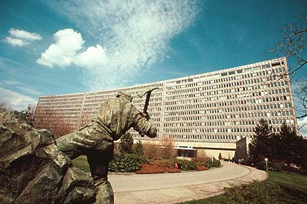
Skills development
Current debate on the Future of Work
Drivers of change
Wrong question: how many jobs are at risk ?

Slide 22
Skills development systems
Foundation skills as basis for LLL
A pressure on skill needs anticipation but is the task doable? Can real time / big data help?
Social dialogue and sectorial approaches – the means to understand and mitigate the change
ALMPs – low skilled, job seekers (beyond the unemployed!), disadvantaged groups

Slide 23
Additional information
Labour underutilization
http://www.ilo.org/global/statistics-and-databases/standards-and-guidelines/resolutions-adopted-by-international-conferences-of-labour-statisticians/WCMS_230304/lang--en/index.htm
Youth Guarantee
http://www.ilo.org/employment/areas/youth-employment/WCMS_544147/lang--en/index.htm
Future of Work
http://www.ilo.org/global/topics/future-of-work/lang--en/index.htm
Skills for Employment Knowledge Sharing Platform
http://www.skillsforemployment.org/KSP/en/index.htm

Slide 24

For further information:
zampini@ilo.org

