Slide 1




Portraits of Labor Market Exclusion 2
Snapshots from Bulgaria, Croatia, Hungary and Romania
CPESSEC Conference
Budapest, November 8, 2017

Slide 2
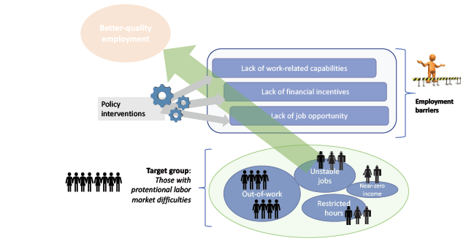
Project Rationale
Activation and employment support policies- should be tailored to individual barriers, characteristics.
But data on such characteristics is scarce.
We only talk about “youth”, “women”, “older workers”, “people with disabilities” and make assumptions about barriers of broad categories of individuals.
So how do we know if the right programs and policies are in place?
Portraits of Labor Market Exclusion separates the out of work and marginally employed population into distinct groups according to the employment barriers they face- Big Picture Snapshot
contributing to a potential better match between individual needs and available support, making policy interventions more effective
And takes stock of existing policies to assess whether they:
address the common employment barriers of priority groups?
are available and accessible for the various distinct groups identified?
Employment Barrier Framework

Slide 3
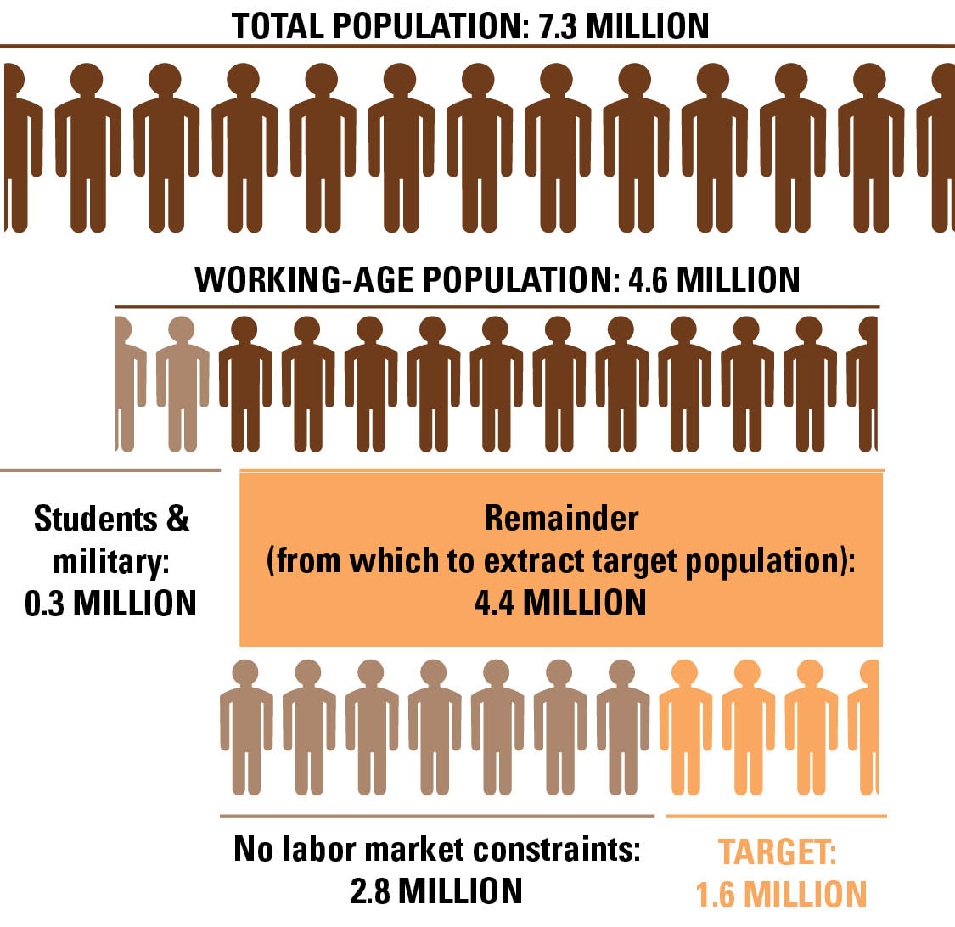
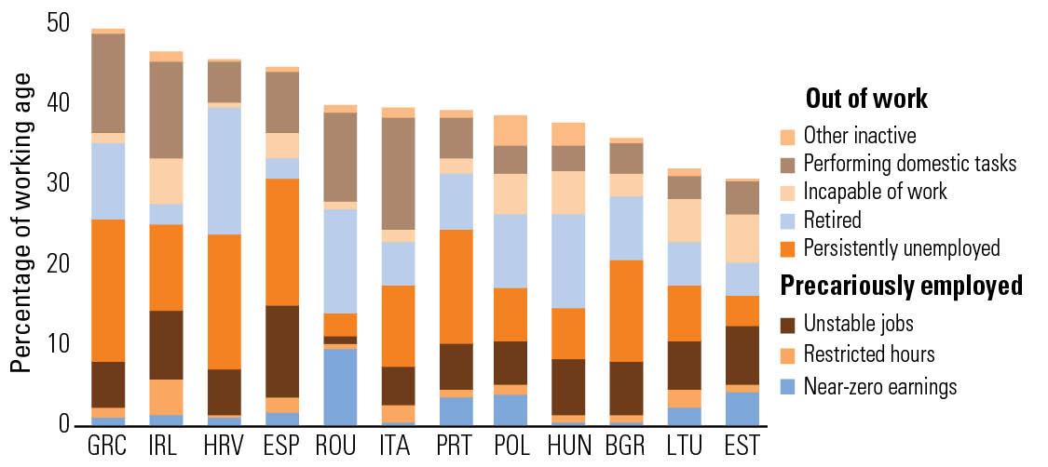

Significant share of working age population has potential LM difficulties, but with notable differences
The composition target population also differs: significant shares of out of work (unemployed, retired, perform domestic tasks most common) and lower shares of precariously employed in most
Identification of Target Population
Bulgaria

Slide 4
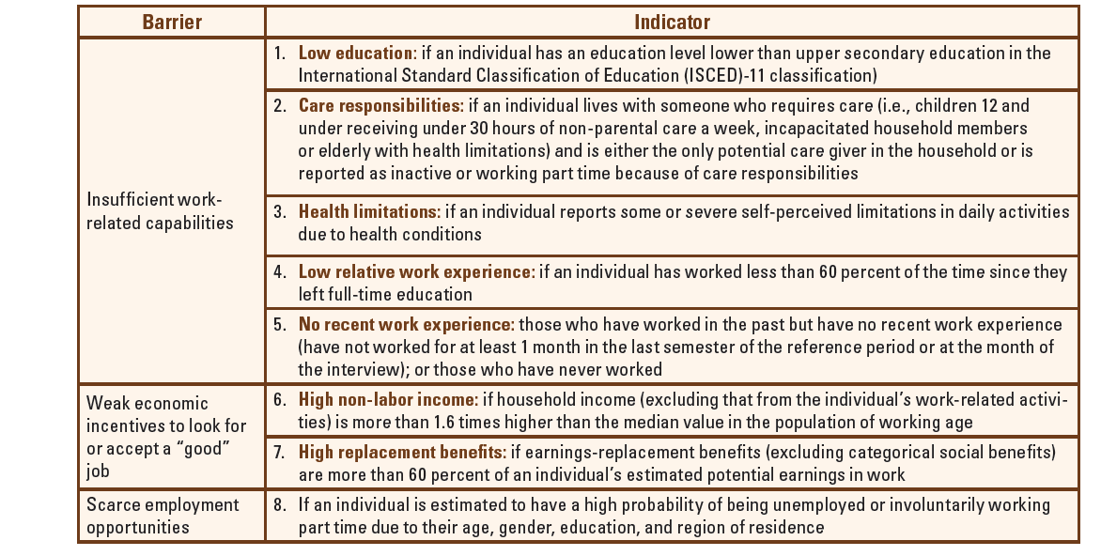
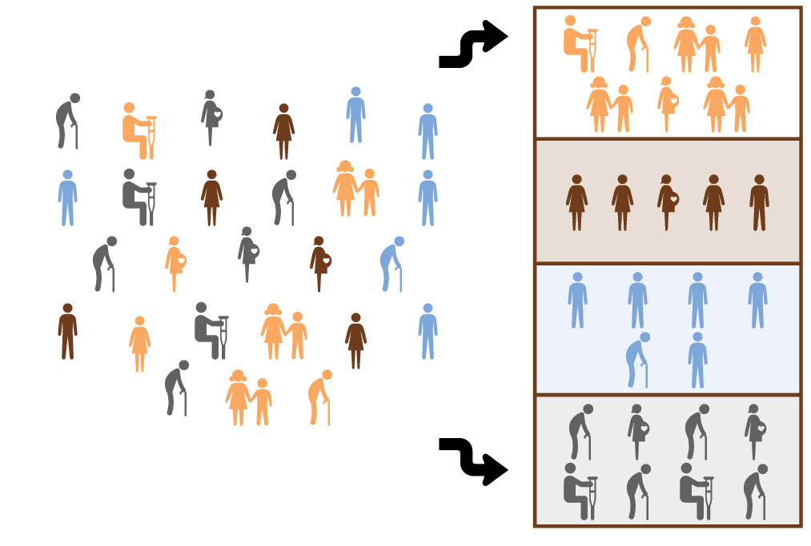
Latent Class Analysis…. Segmenting the target population into distinct groups using an employment barrier framework
Employment Barrier Indicators
Latent Class Analysis

Slide 5
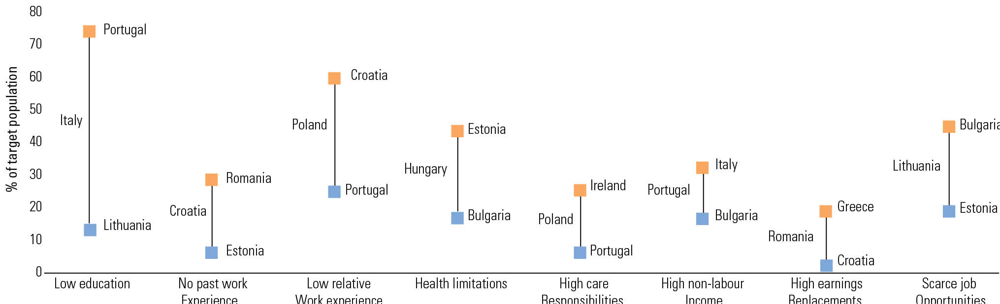
Incidence of barriers largely depend on the context: Low skills/education & low relative work experience most prevalent; generous earnings replacements least

Slide 6
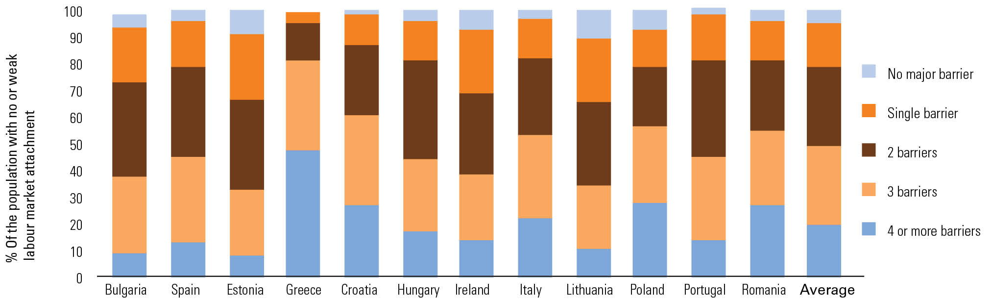
Large share of “target” population face multiple barriers, with 40% facing 3 or more barriers in most countries

Slide 7
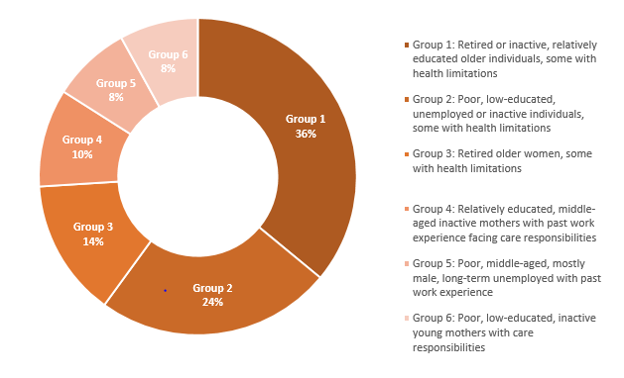
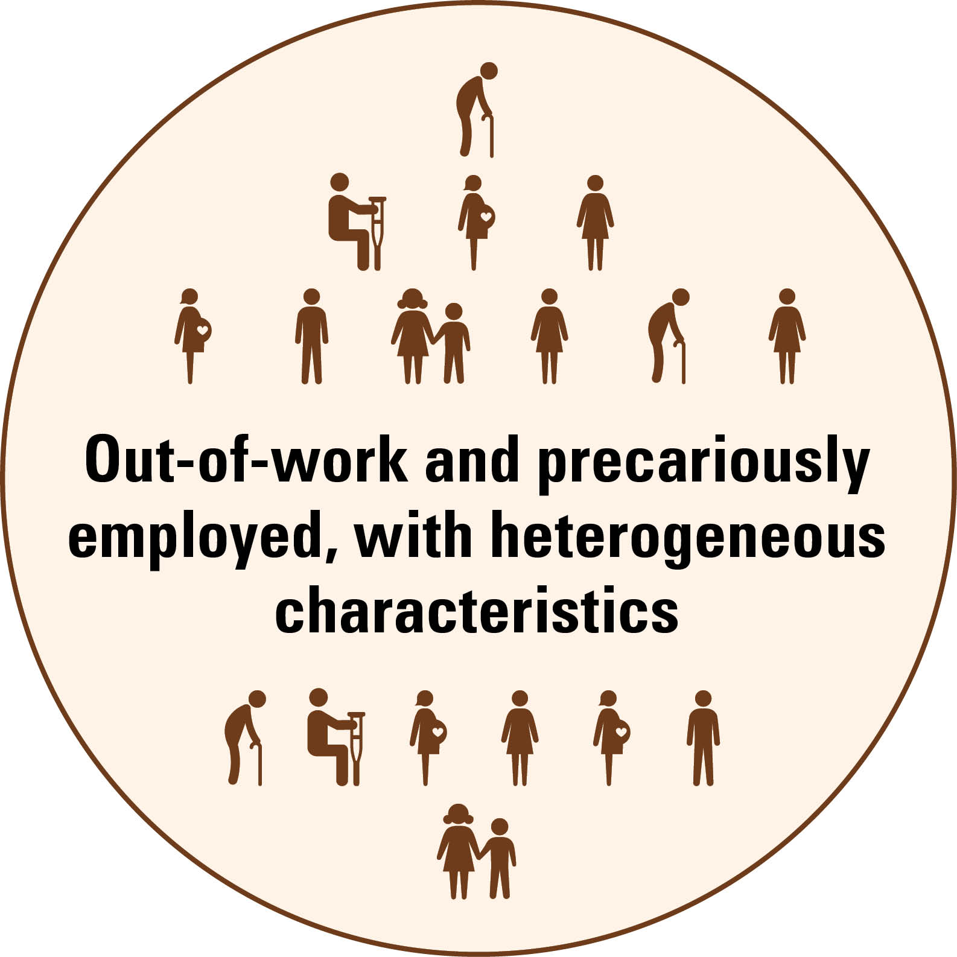
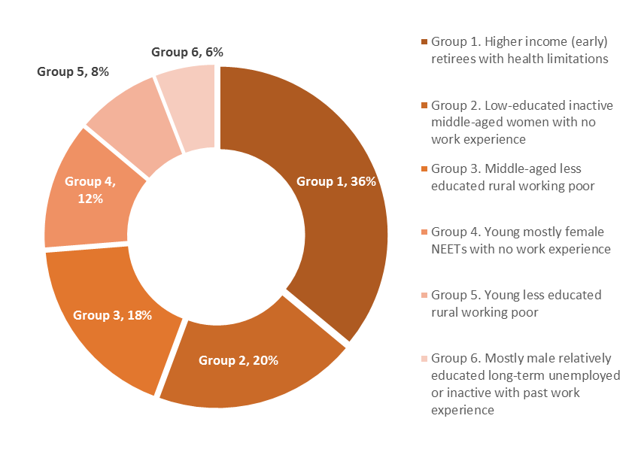


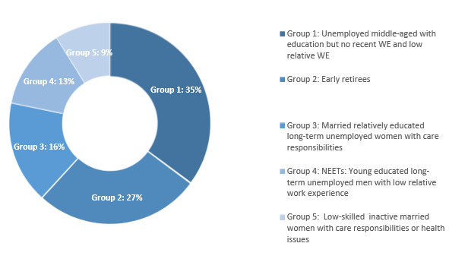
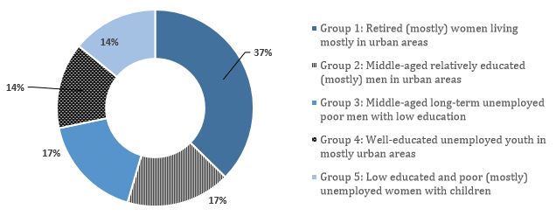


The analysis leads to different groups reflecting the diverse barriers and characteristics of the LM vulnerable in each country

Slide 8
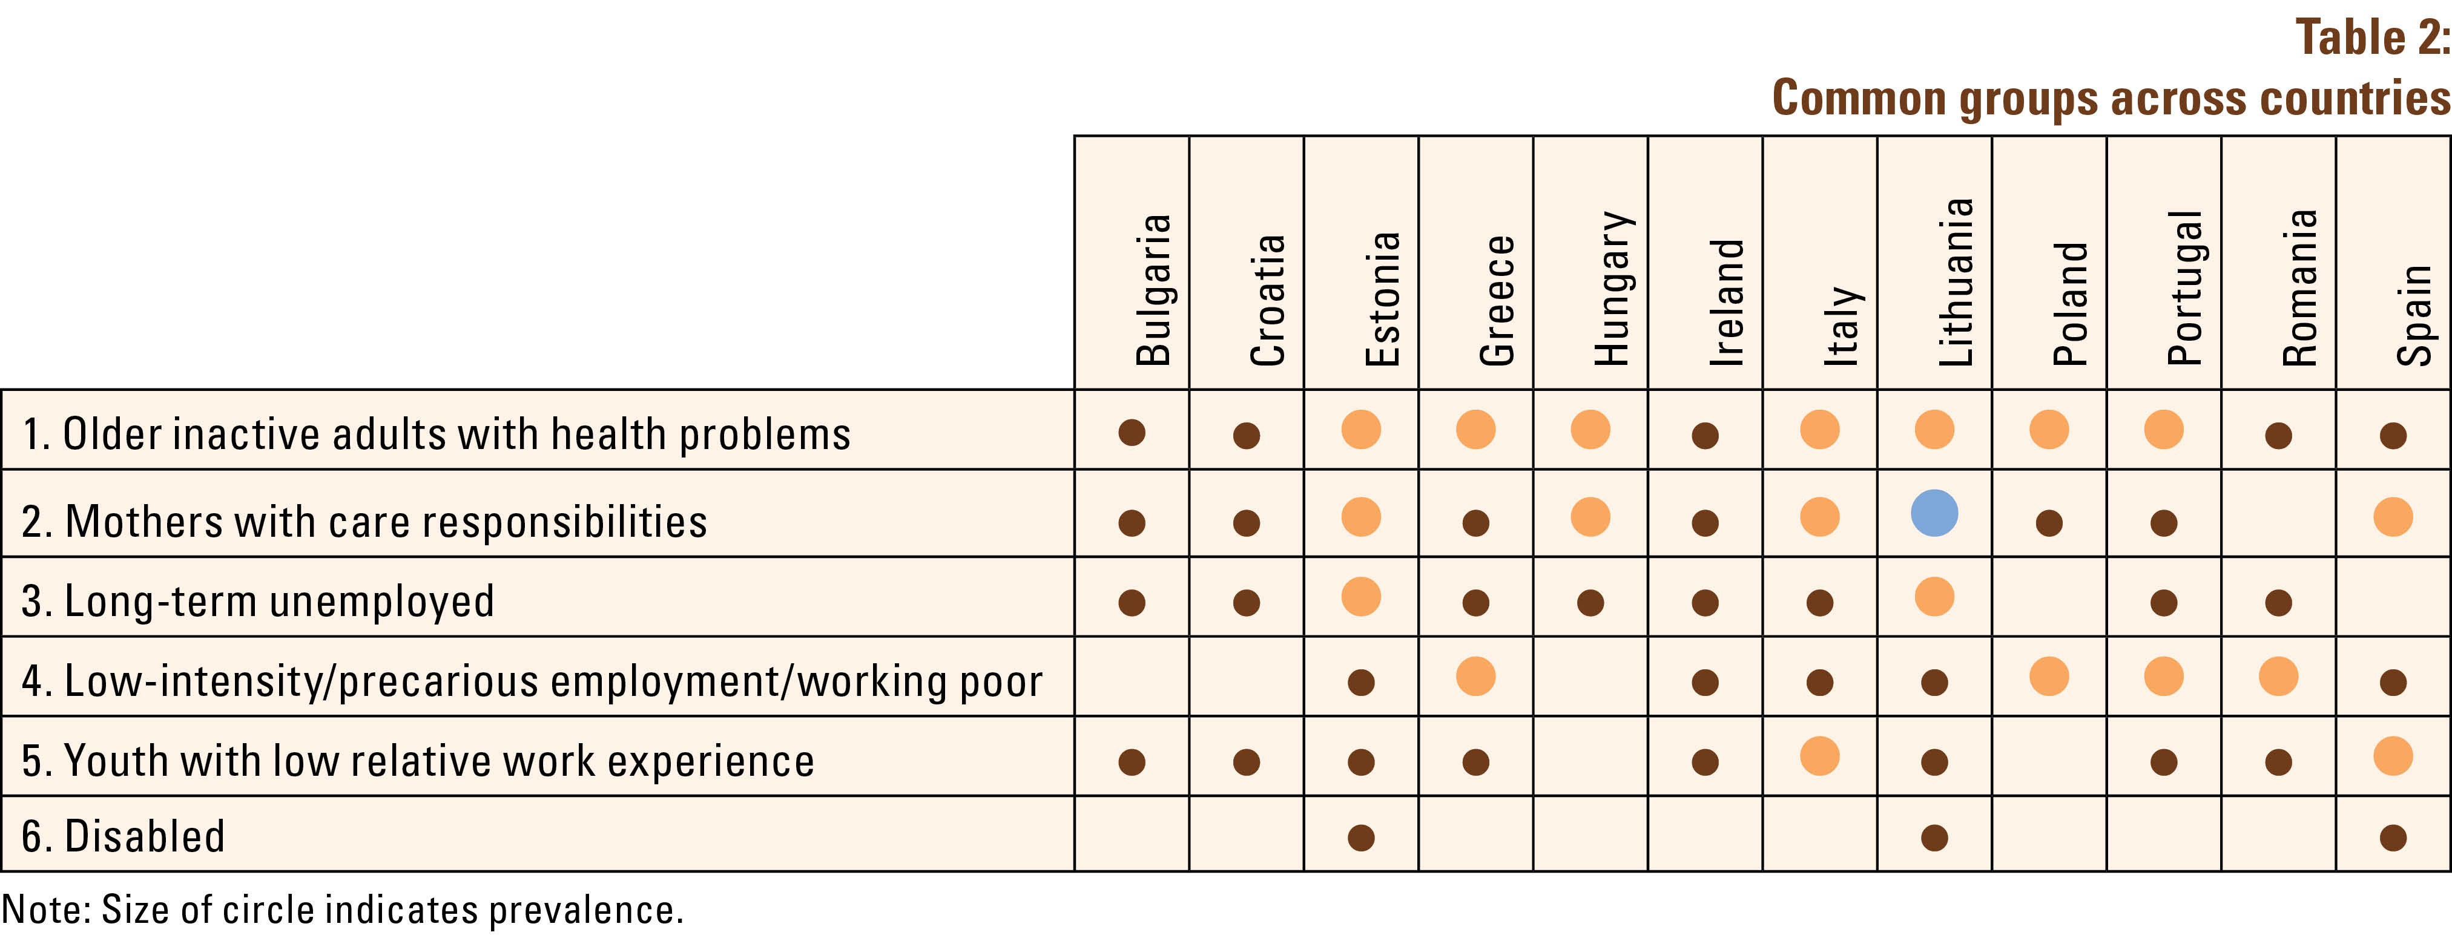
However, common trends have emerged

Slide 9
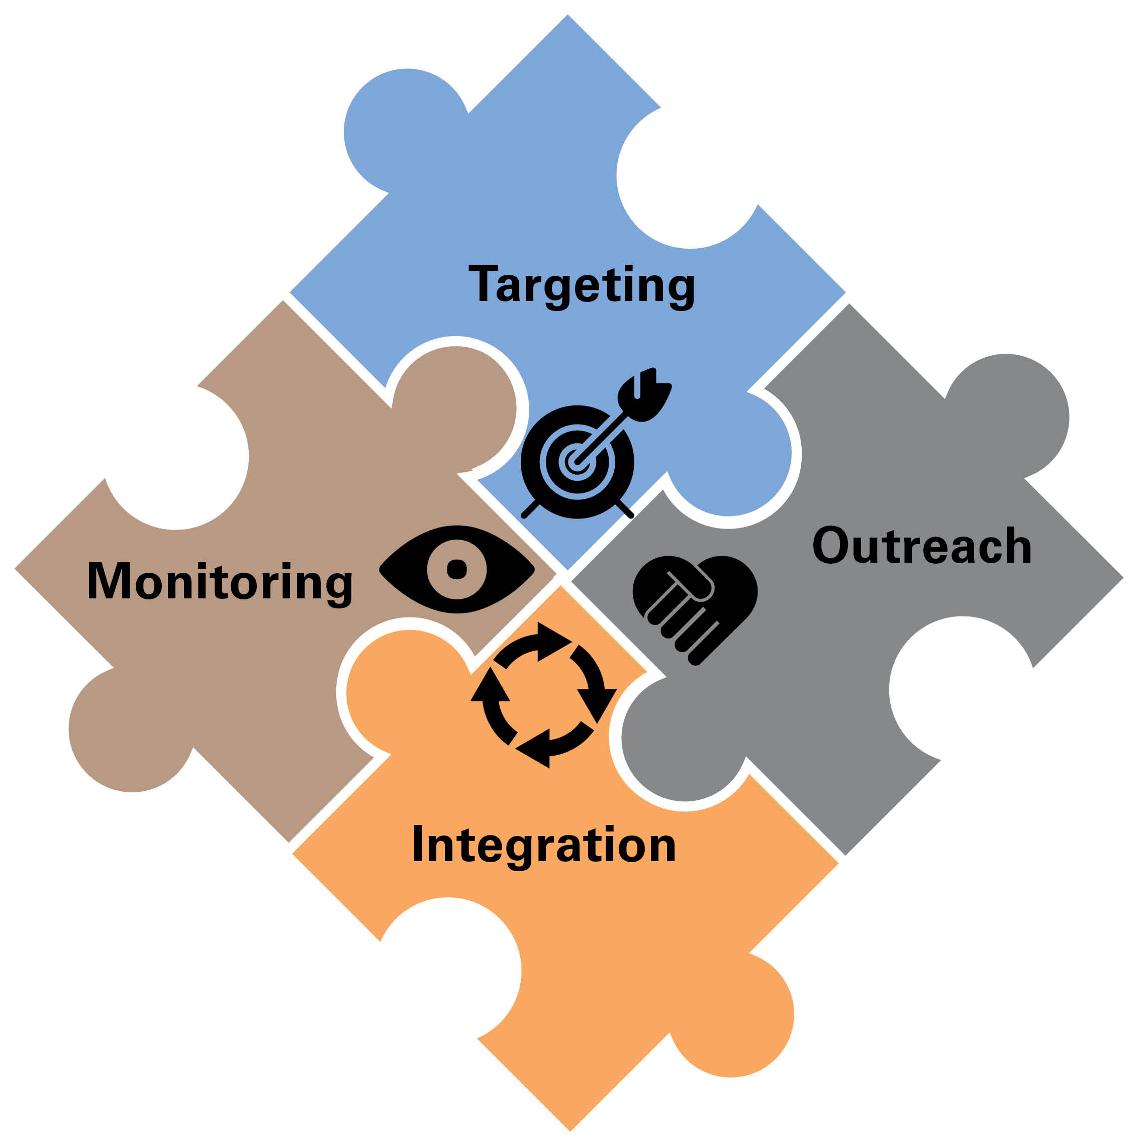
Policies and programs differ across countries - and point to common emerging challenges
Targeting and tailoring design of Activation and Employment Support Programs
(2) Improving outreach, employment promotion, and individualized services
(3) Integrating services to address diverse barriers
(4) Rigorous Monitoring and Evaluation

Slide 10
THANK YOU!
Portraits of Labor Market Exclusion 2
Snapshots from Bulgaria, Croatia, Hungary and Romania
Budapest, November 8, 2017

Slide 11
Annex
Reality on the ground
SNAPSHOTS FROM PORTRAITS

Slide 12


Policies and programs differ across countries however some common themes emerge……
Fragmentation of activation and employment support programs
Though nascent in many, countries are starting to adopt a more coherent approach with menus of coordinated programs and services (e.g. BLG)
Proliferation of programs with low coverage, and limited capacity in some key services, in particular, on childcare (e.g. POL, HRV, GRC)
Integration across Social Assistance (e.g. GMI), PES and social services at different stages
Low across newer EU member states and Mediterranean countries
Different approaches under implementation; physical versus data/system based

Slide 13



Policies and programs differ across countries however some common themes emerge……
Relatively low (national) spending on ALMPs (e.g. in HRV and ROU)
Low coverage, and not all needs are addressed for those who are covered
ALMP spending is not always targeted to priority needs
e.g. skewed towards relatively well educated/skilled youth
who are short term unemployed as opposed to low educated LTU with low work experience
Few monitoring & evaluation best practices
e.g. lack of data exchange between institutions
Lack of national framework for identifying outcomes and assessing impacts

Slide 14
Pointing to Common Emerging Challenges…
Targeting and tailoring design of Activation and Employment Support Programs
Assessment of needs/barriers through different methods (statistical profiling, employment counsellor etc.)
Cross-cutting institutional methodological consistency
(2) Improving outreach, employment promotion, and individualized services
Joint outreach activities on employment promotion and specialized services, in particular, targeting priority groups living in rural or remote areas
Referral and placement onto ALMPs/services: driven by demand and services available on a continuous basis
Delivery capacity: private versus public provision
(3) Integrating services to address diverse barriers
Devising a menu of policies and programs that are complementary (e.g. Relevant ALMP plus child care, mobility allowance; social benefits designed to promote work)
Integration of data systems regardless of status of physical integration/coordination efforts
(4) Institutionalizing Monitoring and Evaluation
Systematic approach to collect and utilize administrative data
Regularly assessing effectiveness of ALMPs → esp. cost effectiveness
Using evaluation results to tweak intervention designs

